Slide 1
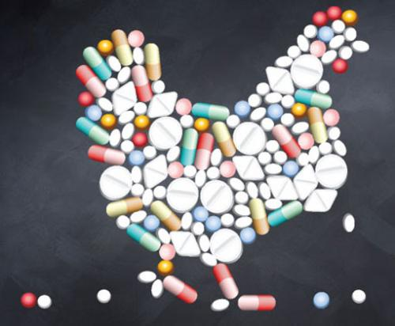
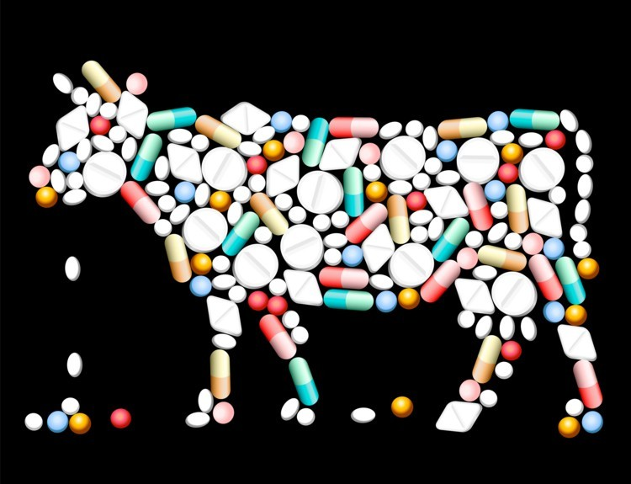
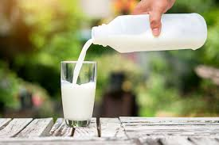
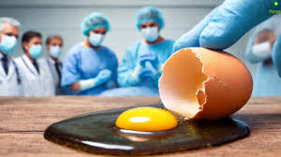
Antibiotics residues in meat, milk products and egg

Slide 2
What is antibiotic?

Slide 3
A medicine fight bacterial infections in animal and human either by killing the microorganism (bactericidal) or keeping them from proliferation themselves (bacteriostatic).

Slide 5
What is the mechanisms of antibiotics?

Slide 7
What are the sources of antibiotics?

Slide 8
Antibiotics are produced naturally by one microorganism or produced synthetically or semi synthetically in the laboratory.

Slide 9
What are 4 routes methods by which you may administer antibiotics to animals?

Slide 10
Antibiotics could be injected intravenously, intramuscularly, subcutaneously or administered orally

Slide 11
What are uses of antibiotics?

Slide 12
Antibiotics are generally used on farms animals for different functions include:
Antibiotics as therapy: Exposure of animal to high dose of antibiotic for relatively shorter periods
Antibiotics as prophylaxis: exposure of animal to moderate dose of antibiotic for longer time durations
Antibiotics as growth promoters: exposure of animal to a low dose of antimicrobial for a very long duration or throughout the entire lifespan of the animals. Antibiotic growth promoters are inhibited the gut bacteria leaving more nutrients for animal to be absorbed for greater growth

Slide 13
What are the common antibiotics classes used in chicken farming?

Slide 14
Penicillines
Tetracyclines
Macrolides
Aminoglycosides
Fluoroquinolones
Sulfonamides

Slide 16
Medications that disappeared rapidly from the body also disappear from egg white in 2-3 days and from yolk in 10 days after cessation of exposure

Slide 17
What is the impact of antibiotic residues found in meat, milk products, and egg on human health?

Slide 18
Antibiotic residues can cause:
An allergic reaction
Imbalance of intestinal microbiota
Development of resistance bacteria against antibiotics

Slide 19
What are mechanisms of antibiotic resistance?

Slide 20
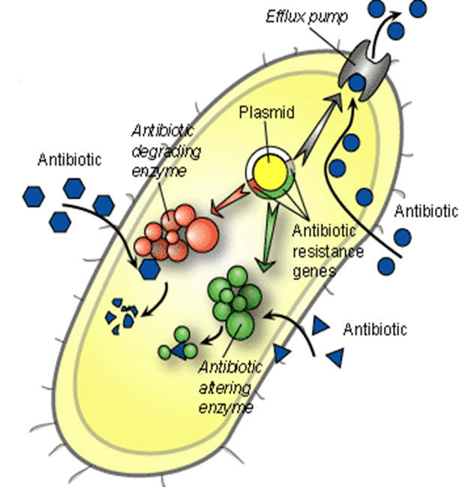
Enzymatic destruction of drug
Prevention of penetration of drug.
Alteration of antibiotic target site.
Rapid ejection of the drug

Slide 21
what factors promote antimicrobial resistance?

Slide 22
Exposure to sub-optimal levels of antibiotics (misuse).
Exposure to microbes carrying resistance genes.

Slide 23
How can detect the antibiotic residues in egg?

Slide 25
How can detect the antibiotic residues in milk?

